Slide 1
Bench Scale And Pilot Plant Tests For Circulating Load
In The Crushing And Milling Circuit
Supervisor: Dr. Karimi
Presenter: Hamid Faramarzi
Imam Khomeini International University, Qazvin, Iran.

Slide 2
Content
Introduction
Circulating load calculate
Most factories the purpose of control
Effective factors for circulating load
Test design
Conclusion
References

Slide 3
circulating load ratio
circulating load ratio :
As the ratio of the amount of solids going through the ball mill divided by the amount of solids going through the circuit.
Circulating load
circulating load ratio
New feed
[8]

Slide 4
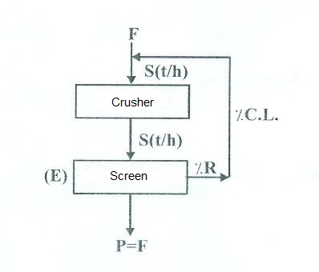
Circulating load calculate
E = Efficiency Screen %
R = Larger than mesh %
S = C.L. + new feed (t/h)
f = larger than mesh in feed %
C.L. = circulating load
[2]
Slide 4

Slide 5
Circulating load calculate
For being equal F and P , quantitative of fine material must be poured onto screen to pass equivalent weight of F from screen throe is not all this amount in the first load.
[7]
E = Efficiency Screen %
R = Larger than mesh %
S = C.L. + new feed (t/h)
f = larger than mesh in feed %
C.L. = circulating load
[2]

Slide 6
performance characteristics
Closed grinding circuit CSE, and our ability to maximize it, can be regarded as a function of two grinding circuit performance characteristics
the circulating load ratio;
the basic (or reduced) classifier separation performance [6];
Circulating load ratio is enormously important to grinding circuit efficiency. Diminishing returns dictate optimum economic operational values of approximately 350% to 400% for most primary ball milling circuits. [6]

Slide 7
effective factors for circulating load
There are two strategy based on the change of feed rate or added water to classifier.
First strategy : size of product is controlled by rate of feed and Circulating load by the rate of added water. [8]
Second strategy : size of product is controlled by the rate of added water would be controlled.
If the reaction of ingredient be much faster , the added water would be controlled .
If the reaction of mill capacity be much faster , the rate of feed would be set.
[8]

Slide 8
effective factors for circulating load
One of the problems of mentioned strategies is interaction between agents.
One for thing , rising water cause to increase the circulating load which itself change the size of product. [3]
Similarly by increasing the rate of food the size of products enhance too.
The more circulating load :
The more long grading Uniform,
The less Slime product and
The less energy consumption will be.
The less Retention time. [7]

Slide 9
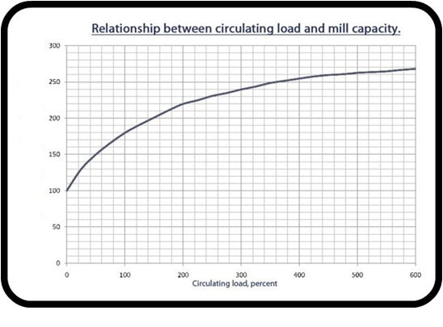
effective factors for circulating load
In this typical circuit arrangement, higher circulating load ratio is necessarily associated with loss of cyclone classifier basic sharpness of separation and increased bypass of fines. This leads to the diminishing returns (in terms of increased CSE and overall circuit efficiency) with increased circulating load ratio. [6]
quantity of new -50 micron material , percent
Slide 9

Slide 10
effective factors for circulating load
When increasing pumping energy and pump and cyclone maintenance costs are balanced against decreasing grinding energy and media costs, all as circulating load increases, the optimum economic circulating load can be identified, as it was at Kidd Creek (Table ). [4]
The circulating load ratio was lowered from an average of approximately 450% to 350% through appropriate, systematic pump and cyclone adjustments. [5]

Slide 11
effective factors for circulating load
Effective parameters on the design
Main parameters
Added water
Mill capacity
Subsidiary parameters
transfer cost
In mill
New feed
classifier basic sharpness
hardness and size distribution at new feed
important parameters

Slide 12
Test design
Main purpose
Maximum Capacity
Cost low Energy
Less fines Production
Size Division
Bond's work index

Slide 13
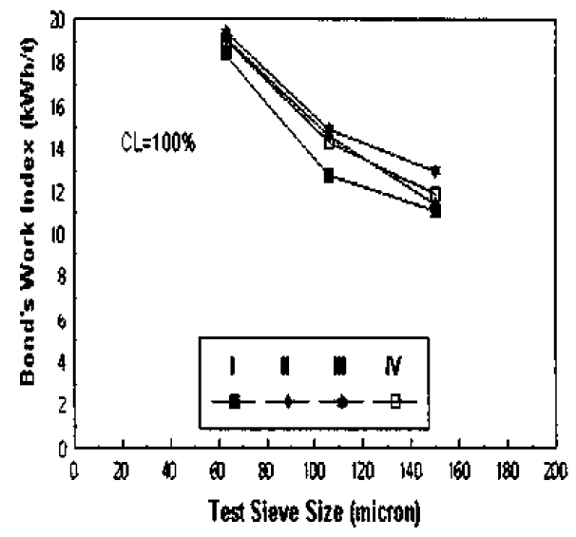
Test design
Effect of circulating load on Bond's work index
The follow figures shown variation in the Bond work index with test sieve size as test results[7].
Variation of Bond work index with circulating load. C.L. =100%

Slide 14
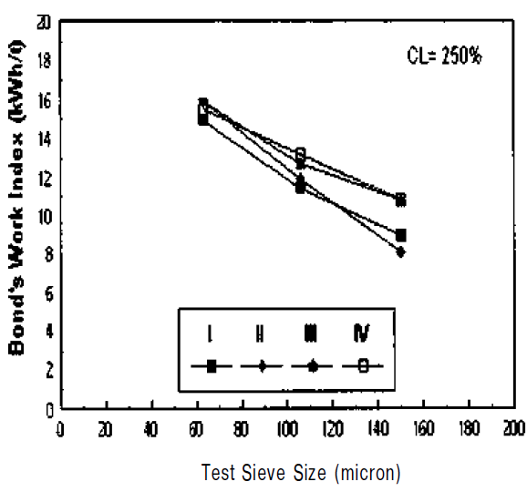
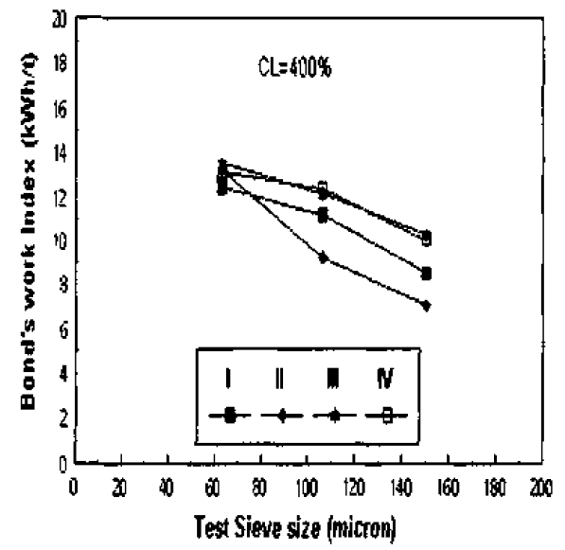
Test design
Variation of Bond work index with circulating load. C.L. = 250% [7]
Variation of Bond work index with circulating load. C.L. = 400%[7]

Slide 15
Conclusions
There are two strategy based on the change of feed rate or added water to classifier.
One of the problems of mentioned strategies is interaction between agents .
The more circulating load:
The more long grading Uniform,
The less Slime product and
The less energy consumption will be.
When increasing pumping energy and pump and cyclone maintenance costs are balanced against decreasing grinding energy and media costs.
The Bond's work index values increased as test sieve size decreased.

Slide 16
Bond work index is changed with the change in the test sieve size and circulating load. This must be taken into account when energy consumption is calculated according to the Bond formula.
unit energy cost extra increased as circulating load decreased from 250%. However, unit energy cost decreased as circulating most suitable circulating load for amorphous silica used experiments is 250% because mill capacity is decreased.

Slide 17
Reference
Introduction to Mineral Processing Design and Operation A.Gupta and D.S.Yan Perth,Australia,January2006
Mineral Processing Technology B.A.WILLS, BSC, PHD, CENG 1997
MINERAL PROCESSING By E. 1. PRYOR THIRD EDITION 2002
Principles of Mineral Processing by Maurice C. Fuerstenau and Kenneth N. Han 2009
Mineral processing handbook Thirteenth Edition 2011
Recent advances in mineral processing plant design.
The Effect of Circulating Load and Test Sieve Size on The Bond Work Index Based on Natural Amorphous Silica. V. Deniz. N. Sütçü & Y. Umucu , 2003
8. جزوه مهندسی خردایش بنیسی صمد 1391

